Slide 1

Covid-19 India Analysis
By: Pritam Jal
Sahil Jamwal

Slide 2
Introduction
The pandemic of Coronavirus Disease 2019 (COVID-19) is a timely reminder of the nature and impact of Public Health Emergencies of International Concern.
There were over 314 million cases and over 5.5 million deaths notified since the start of the pandemic.
The COVID-19 pandemic takes variable shapes and forms, in terms of cases and deaths, in different regions and countries of the world.
The objective of this study is to analyse COVID-19 pandemic in India.

Slide 3
Insights
Tested:
Confirmed:
148,172,480,900
8,188,782,448
Recovered:
Death:
7,721,021,670
109,882,126

Slide 4
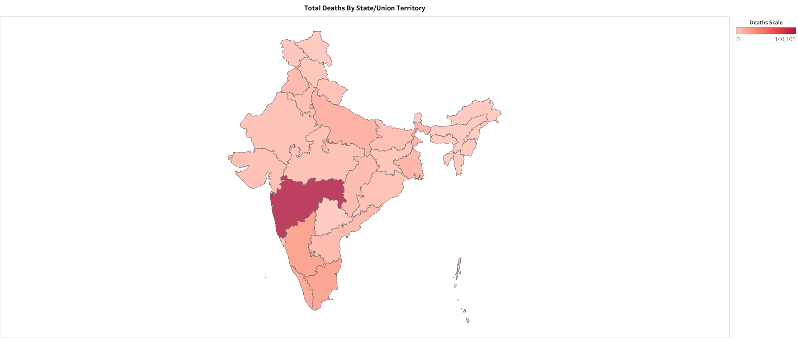
Key Findings
Max Deaths has been seen in the state of Maharastra with a death count of 140216

Slide 5
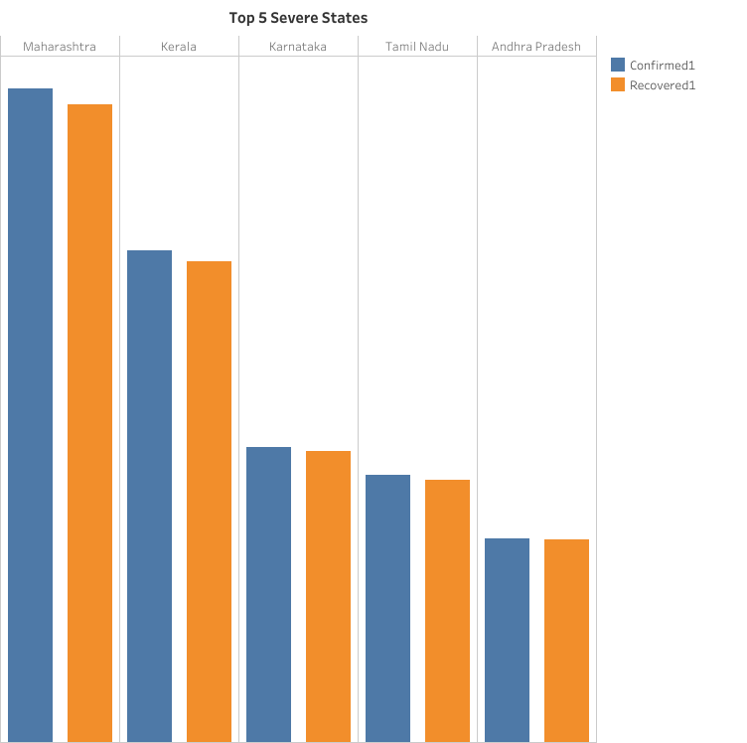
Top five severe state in India with respect to Confirmed Cases.
Maharashtra
Kerala
Karnataka
Tamil Nadu
Andhra Pradesh

Slide 6
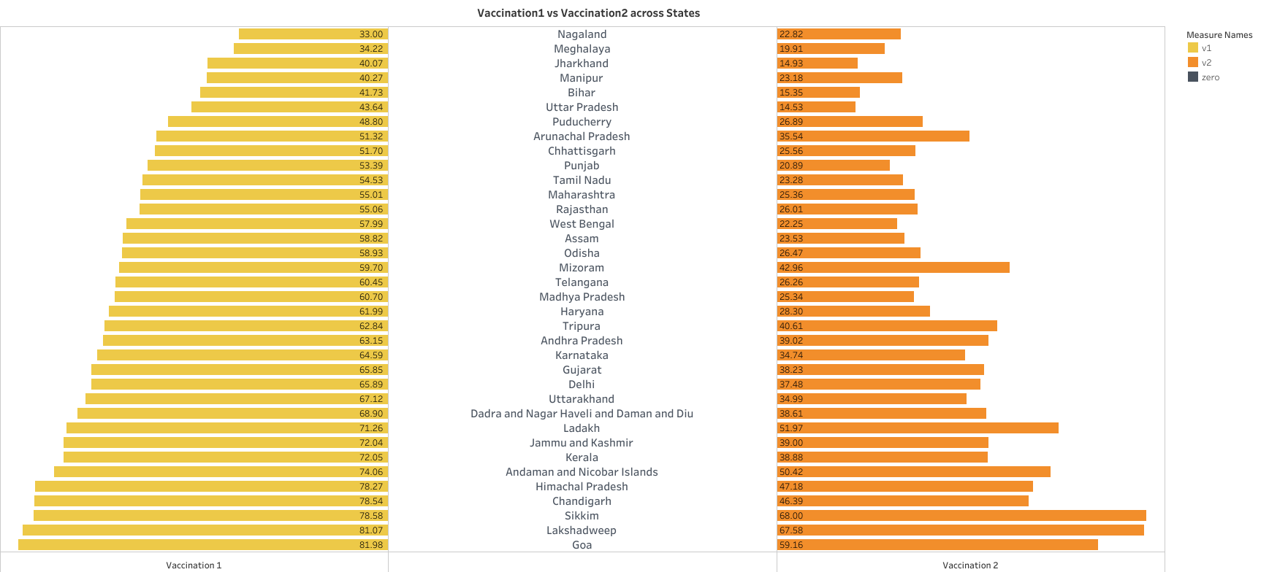
It can be seen that most people have taken the 1st vaccination but not the 2nd vaccination.
Also we can see that Goa is the most Vaccinated state and Nagaland is the least Vaccinated state.

Slide 7
Challenges and Learning
Learning about request module.
Converting JSON to CSV was the practical application of our learnings of the unit.
Remote Collaboration.
Learnt to work as a team.

Slide 8
Thank You

